Slide 1
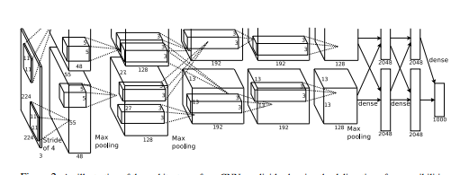
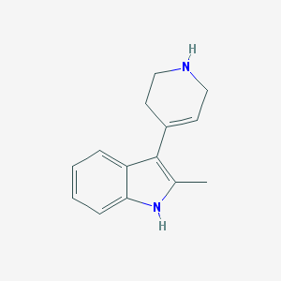
Constructing a convolutional neural net (cNN) for structure-activity prediction
INPUT
Convolutional neural network
OUTPUT
Active/ Inactive
classification
or
Activity score
regression
A. Krizhevsky, I. Sutskever, and G. Hinton. ImageNet classification with deep convolutional neural networks. In NIPS, 2012.

Slide 2
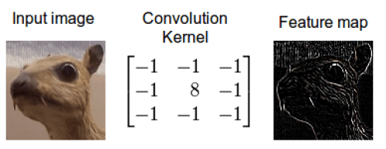
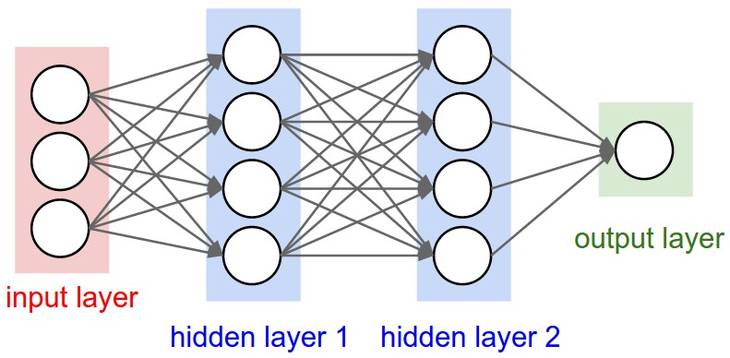
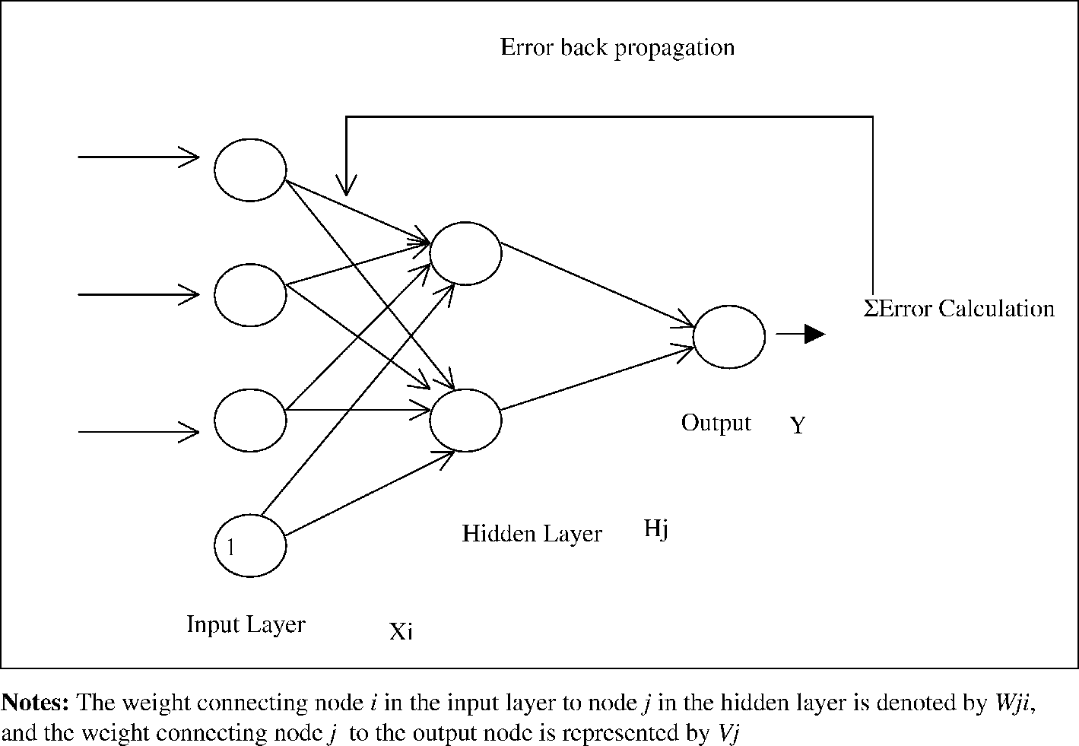
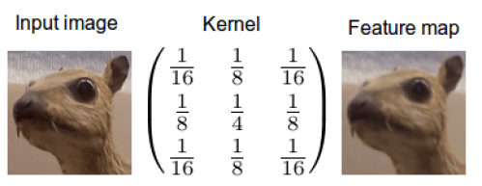
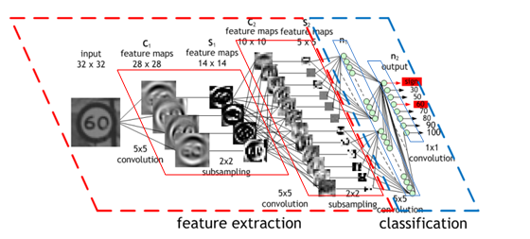
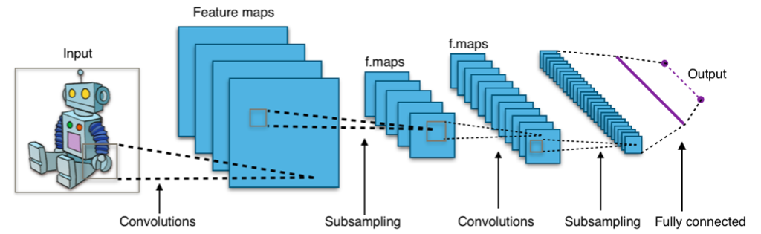
Background on Convolutional Neural Networks

Slide 3
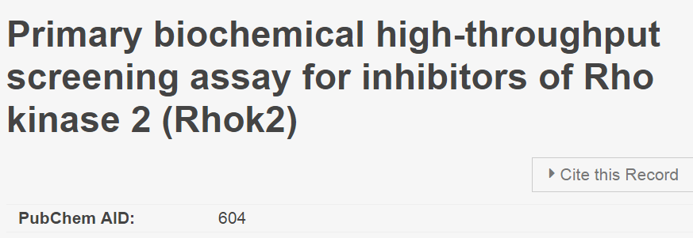
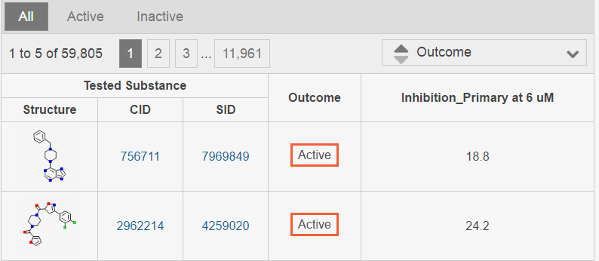
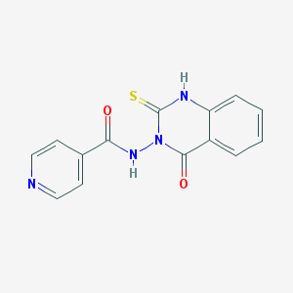
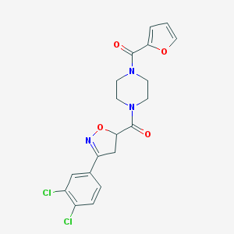
Data
Total Cmpds | Active | Inactive | % Active
59805 | 212 | 59593 | 0.35%
Count: 59,805
Resolution: 300x300pxl

Slide 4
Batch 1
Preparation of Data
Count: 10,000
# actives: 54
Batch 2
Count: 10,000
# actives: 15
download
Batch 3
Count: 10,000
# actives: 56
Count: 59805
Resolution: 300x300pxl
Batch 4
Count: 10,000
# actives: 33
Batch 5
Count: 10,000
# actives: 24

Slide 5
Preparation of Data
Batch 1
Batch 1
cNN data
Count: 10,000
# actives: 54
arbitrarily chosen as main dataset
Supplemental actives from other batches are added
Count: 10,128
# active: 182
% active: 1.8%
Batch 2
Count: 10,000
# actives: 15
Batch 3
Count: 10,000
# actives: 56
Batch 4
Count: 10,000
# actives: 33
Batch 5
Count: 10,000
# actives: 24
Jupyter notebook: https://nbviewer.jupyter.org/github/ec1340/AID604NN/blob/master/data_prep/Preparation_of_data.ipynb

Slide 6
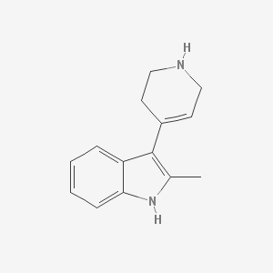

Preparation of Data
RGB intensities
cNN data
[134,34,23] | [134,34,23] | [134,34,23]
[134,34,23] | [213,23,34] | [21,38,24]
[12,45,32] | [123,23,42] | [234,31, 32]
Dimensions: (300,300,3)
Total x/image: 270,000
Convert to grayscale
Down-scale to 100x100 res.
Dimensions: (300,300)
Total x/image: 90,000
Dimensions: (100,100)
Total x/image: 10,000
234 | 192 | 254 | 253 | 243 | 234
238 | 234 | 83 | 254 | 254 | 254
254 | 12 | 123 | 254 | 254 | 254
87 | 254 | 254 | 254 | 254 | 23
254 | 71 | 254 | 254 | 248 | 254
254 | 254 | 254 | 254 | 76 | 254
0 | 0.3 | 0 | 0 | 0 | 0
0 | 0.54 | 0.67 | 0 | 0 | 0
0 | 0.23 | 0 | 0 | 0.8 | 0
0.57 | 0 | 0 | 0 | 0 | 0.2
0 | 0.23 | 0 | 0 | 0 | 0
0 | 0 | 0 | 0 | 0.9 | 0
Normalization of values to range(0,1) improves learning rate

Slide 7
Preparation of Data
Jupyter notebook: https://nbviewer.jupyter.org/github/ec1340/AID604NN/blob/master/label_prep/Preparation_of_labels.ipynb
Classification: y = f(x) “the model assigns an input described by vector x to a category identified by numeric code y. “
Regression:
“In this type of task, the computer program is asked to predict a numerical value given some input. This type of task is similar to classification, except that the format of output is different”
Input: x
Output: y
Label Set 1
cNN data
Count: 10,128
# active: 182
% active: 1.8%
Label set 1: Inactive “0” or Active “1”
Label Set 2
Label Set 3
Source: Goodfellow et al 2016 Book. Deep Learning. Ian Goodfellow, Yoshua Bengio, Aaron Courville, MIT press 2016
Label set 2: Pubchem activity score
Label set 3: Inhibition primary at 6uM

Slide 8
Preliminary run
Jupyter notebook: https://nbviewer.jupyter.org/github/ec1340/AID604NN/blob/master/label_prep/Preparation_of_labels.ipynb

Slide 9
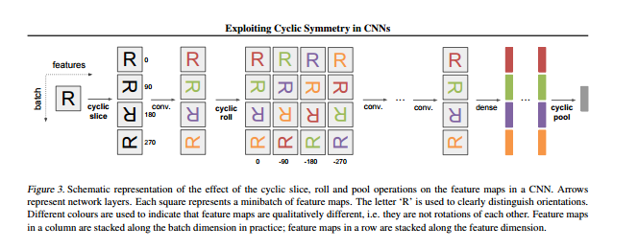
Current Directions:
1. Data Augmentation Increase the number of examples of active compounds the net can “learn” from
Pre-training (transformations applied as a layer in the net)
During training (transformations applied as a layer in the net)
cNN data
Source: S. Dieleman, J. De Fauw, and K. Kavukcuoglu. Exploiting Cyclic Symmetry in Convolutional Neural Networks. ArXiv e-prints, Feb 201

Slide 10
Current Directions:
2. Increase input image quality:
It may be possible that the low resolution of the images are the cause or that the omitting of color (which signifies the presence of a heteroatom) may be removing to much chemical information
Image Quality: Test batches of different resolution and see whether there is a relationship between resolution and performance
Color: Test batches of different resolution and see whether there is a relationship between resolution and performance
cNN data (50x50)
cNN data (100x100)
cNN data (150x150)
cNN data (200x200)
cNN data (50x50)
cNN data (100x100)
cNN data (150x150)
cNN data (200x200)

Slide 11
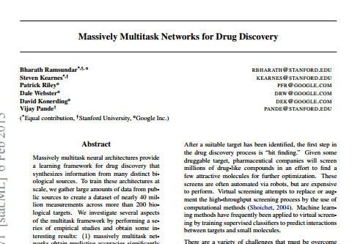
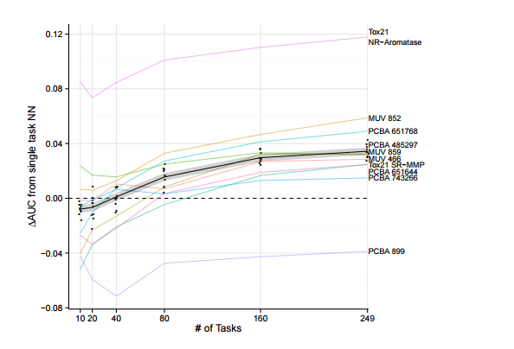
Current Directions:
3. Supplemental datasets or a new one altogether: There is a possibility where the several nets “learn” on different “tasks” (recognizing compounds for different targets) and this may allow the net to learn a better representation of an active compound. A completely new dataset can be chosen as AID604 may be intrinsically difficult to predict compounds for. The dataset is also highly imbalanced and as it is a primary screen, it is likely to contain false positives
New dataset (AID):
-well characterized target
-many active compounds
Muli-task network (transformations applied as a layer in the net)

